Slide 1


2024 Pre-Trib Study Group
Apostasy or Rapture?
(2 Thessalonians 2:3A)
Dr. Andy Woods
Senior Pastor – Sugar Land Bible Church
President – Chafer Theological Seminary

Slide 2
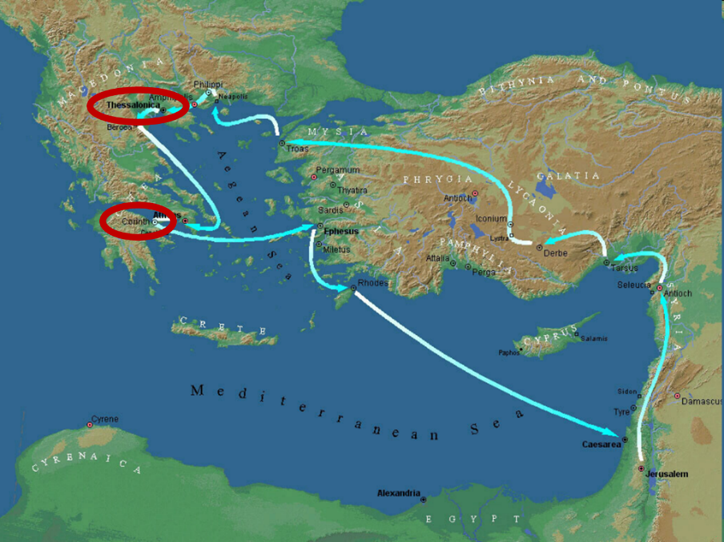

Slide 3


2 Thessalonians 2:2
“that you not be quickly shaken from your composure or be disturbed either by a spirit or a message or a letter as if from us, to the effect that the day of the Lord has come.”

Slide 4

1 Thessalonians 1:10
“and to wait for His Son from heaven, whom He raised from the dead, that is Jesus, who rescues (rhyomai) us from (ek) the wrath (orgē) to come.”

Slide 5
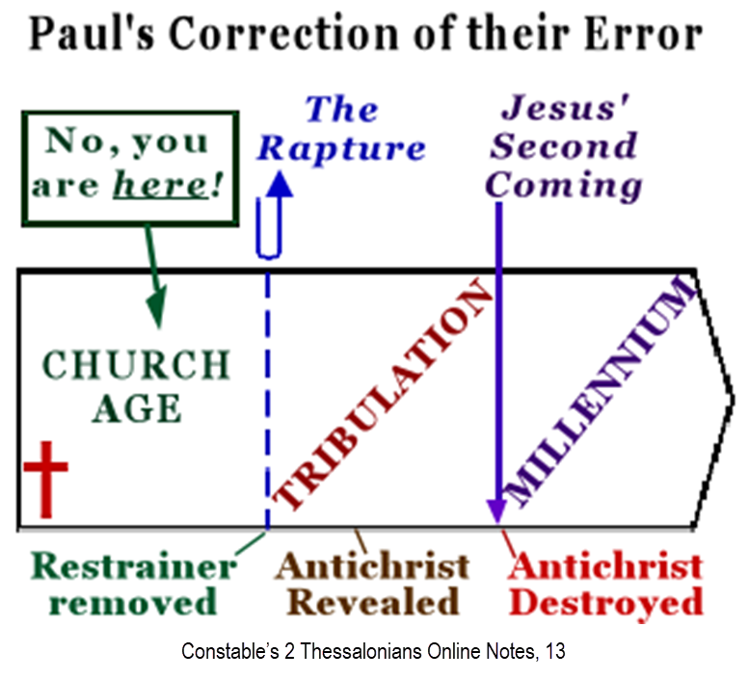

Slide 6
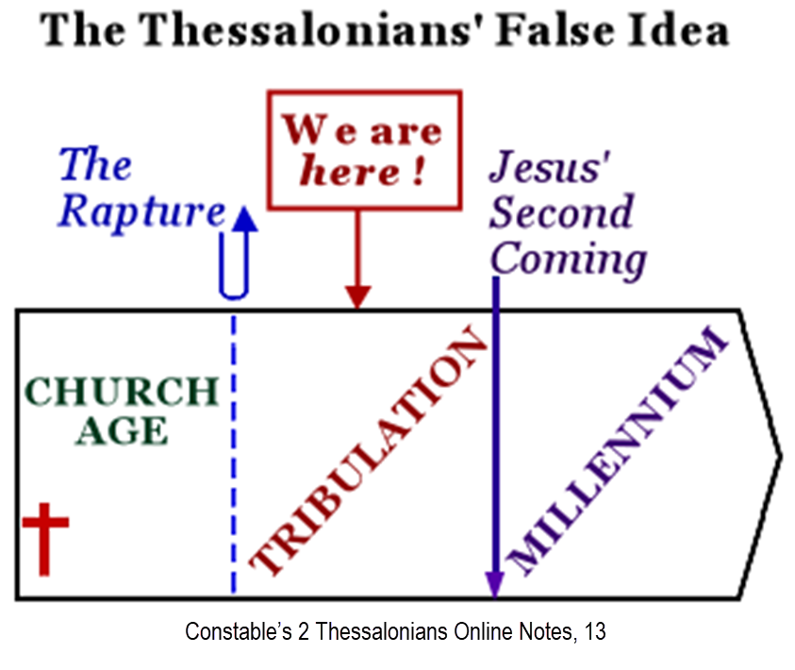

Slide 7
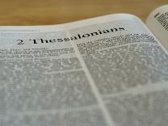
2 Thessalonians 2:1-12
Problem (2:1-2)
Prerequisites for the Day of the Lord (2:3-12)
  The apostasy (2:3a)
  Advent of the lawless one (2:3b-4)
  Removal of the restrainer (2:5-7)
  Destruction of the lawless one (2:8-9)
  Destruction of lawless one’s followers (2:10-12)

Slide 8

2 Thessalonians 2:3
“Let no one in any way deceive you, for it will not come unless the apostasy [apostasia] comes first, and the man of lawlessness is revealed, the son of destruction.”

Slide 9

Apostasy? (2:3a)
Spiritual departure (Acts 21:21) – Departure from the Word
Physical departure (Acts 12:10; 2 Cor. 12:8) – Departure from the World (Rapture)

Slide 10
Apostasy? (2:3a)
Spiritual departure (Acts 21:21) – Departure from the Word
Physical departure (Acts 12:10; 2 Cor. 12:8) – Departure from the World (Rapture)

Slide 11
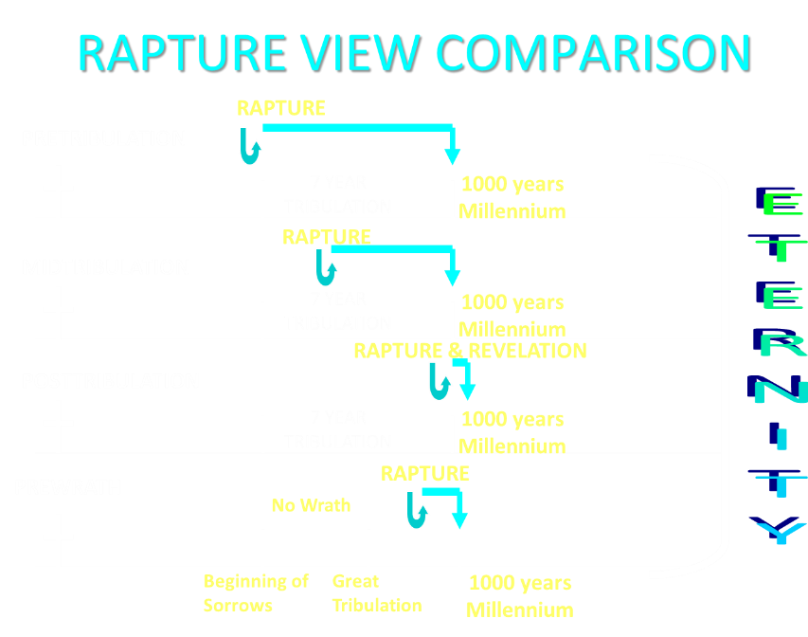

Slide 12
2 Thessalonians 2:3
“Let no one in any way deceive you, for it will not come unless the apostasy [apostasia] comes first [prōton], and the man of lawlessness is revealed, the son of destruction.”

Slide 13

2 Thessalonians 2:3a
Why Physical Departure?
  Inadequacy of spiritual departure interpretations
  Reasons favoring physical departure
  Answering the objections

Slide 14
2 Thessalonians 2:3a
Why Physical Departure?
  Inadequacy of spiritual departure interpretations
  Reasons favoring physical departure
  Answering the objections

Slide 15
Spiritual Departure Options
Apostasy of the Church (pre-rapture)
Apostasy of the World (post-rapture)
Apostasy of Israel (Dan. 9:27)

Slide 16
Spiritual Departure Options
Apostasy of the Church (pre-rapture)
Apostasy of the World (post-rapture)
Apostasy of Israel (Dan. 9:27)

Slide 17
2 Thessalonians 2:3
“Let no one in any way deceive you, for it will not come unless the apostasy [apostasia] comes first [prōton], and the man of lawlessness is revealed, the son of destruction.”

Slide 18
C. Gordon Olson
C. Gordon Olson, The Resurrection New Testament (Lynchburg, VA: Global Gospel Publishers, 2017), 261, n. B.
“‘Let no one deceive you in anyway, for that day will not come unless the departure comes first and the man of lawlessness is revealed, the man doomed to destruction.’….The Greek Apostasy means a departure, as does its verb aphistēmi. It can refer to a physical departure, a spiritual departure, or a rebellion. The rapture of Christians would be a physical departure, which is supported by his announced subject in 2:1, ‘our gathering together unto him’ (cf. 1 Th. 4:13-18). Otherwise, Paul never returned to his declared topic in a lapse of thought, which raises questions. Only two other versions so render it: GNV & WEB.”

Slide 19
Spiritual Departure Options
Apostasy of the Church (pre-rapture)
Apostasy of the World (post-rapture)
Apostasy of Israel (Dan. 9:27)

Slide 20
God’s Estimate of the Lost
Robert P. Lightner, Sin, the Savior, and Salvation, pps. 42-43
Lost (Luke 19:10)
Perishing (John 3:16)
Condemned (John 3:18)
Lovers of darkness/evil (John 3:19-21)
Under divine wrath (John 3:36)
Without spiritual life (John 3:36)
Of their father the devil (John 8:44)
Dead (Eph 2:1)
Demonically energized (Eph 2:2)

Slide 21
God’s Estimate of the Lost
Robert P. Lightner, Sin, the Savior, and Salvation, pps. 42-43
Depraved (Eph 2:3a)
Doomed (Eph 2:3b)
Held captive (Col 1:13; 2 Tim. 26; Acts 26:17-18)
Unable to receive truth (1 Cor. 2:14; 2 Cor. 4:3-4)
Under the control of Satan’s world system (1 John 5:19)
Filled with all unrighteousness (Rom 1:29-32)
Unable to seek God (Rom 3:10-18)
Conceived in iniquity (Ps 51:5)
Desperately wicked (Jer. 17:9)

Slide 22
Spiritual Departure Options
Apostasy of the Church (pre-rapture)
Apostasy of the World (post-rapture)
Apostasy of Israel (Dan. 9:27)

Slide 23
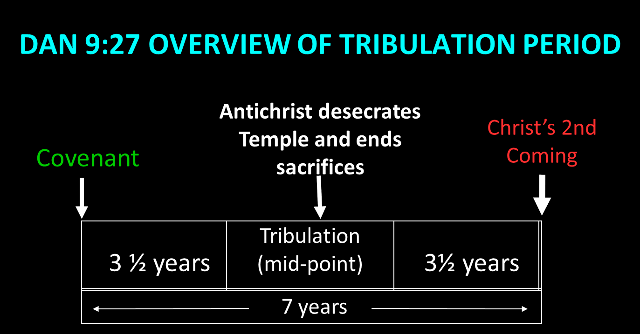

Slide 24
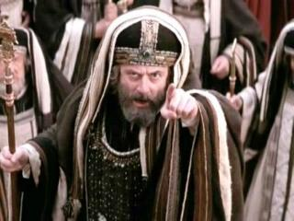
Matthew 12:24
“But when the Pharisees heard this, they said, “‘This man casts out demons only by Beelzebul the ruler of the demons.’”

Slide 25
John 5:43
“I have come in My Father’s name, and you do not receive Me; if another comes in his own name, you will receive him.”

Slide 26
2 Thessalonians 2:3a
Why Physical Departure?
  Inadequacy of spiritual departure interpretations
  Reasons favoring physical departure
  Answering the objections

Slide 27

10 Reasons Favoring Physical Departure
There have always been doctrinal departures
2 Thess. was an early letter
The definite article before apostasia
Noun apostasia can refer to physical departure
Verb aphistēmi can refer to physical departure

Slide 28

2 Thessalonians 2:7
“For the mystery of lawlessness is already at work; only he who now restrains will do so until he is taken out of the way.”

Slide 29

1 John 4:3
“and every spirit that does not confess Jesus is not from God; this is the spirit of the antichrist, of which you have heard that it is coming, and now it is already in the world.”

Slide 30
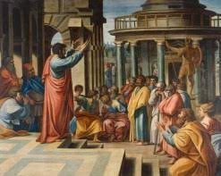
Acts 19:10
“This took place for two years, so that all who lived in Asia heard the word of the Lord, both Jews and Greeks.”

Slide 31

2 Timothy 1:15
“You are aware of the fact that all who are in Asia turned away from me, among whom are Phygelus and Hermogenes.”

Slide 32
Henry M. Morris
The Defender's Study Bible: King James Version (Iowa Falls, IA: World Bible Publishers, 1995), 1338.
“2:3 falling away…The entire context, before and after, fits this understanding of the text better than the idea of the apostasy from the faith. Over the 1950 years since Paul wrote these lines, there have been numerous great apostasies from the faith, and none of these introduced the day of the Lord, although the persecuted believers in each case might easily have so interpreted them.”

Slide 33
10 Reasons Favoring Physical Departure
There have always been doctrinal departures
2 Thess. was an early letter
The definite article before apostasia
Noun apostasia can refer to physical departure
Verb aphistēmi can refer to physical departure

Slide 34
ORDER OF PAUL’S LETTERS | ORDER OF PAUL’S LETTERS
1. | Galatians | A.D. 49
2. | 1‒2 Thessalonians | A.D. 51
3. | 1‒2 Corinthians | A.D. 56
4. | Romans | A.D. 57
5. | Ephesians, Colossians, Philemon, Philippians | A.D. 60‒62
6. | 1 Timothy, Titus | A.D. 62‒66
7. | 2 Timothy | A.D. 67

Slide 35
Unique Characteristics of 1-2 Thessalonians
Small amount of time in between planting of the church and the first letter to the church
Every chapter ends with a reference to the Second Advent

Slide 36
Acts 20:29-31
“For I know this, that after my departure savage wolves will come in among you, not sparing the flock.”Also from among yourselves men will rise up, speaking perverse things, to draw away the disciples after themselves. Therefore be on the alert, remembering that night and day for a period of three years I did not cease to admonish each one with tears.” (Italics added).

Slide 37
1 Timothy 4:1
“But the Spirit explicitly says that in later times some will fall away [aphistēmi] from the faith, paying attention to deceitful spirits and doctrines of demons.”

Slide 38
10 Reasons Favoring Physical Departure
There have always been doctrinal departures
2 Thess. was an early letter
The definite article before apostasia
Noun apostasia can refer to physical departure
Verb aphistēmi can refer to physical departure

Slide 39
2 Thessalonians 2:3
“Let no one in any way deceive you, for it will not come unless the apostasy [apostasia] comes first, and the man of lawlessness is revealed, the son of destruction.”

Slide 40
2 Thessalonians 2:3
“Let no one in any way deceive you, for it will not come unless the apostasy [apostasia] comes first, and the man of lawlessness is revealed, the son of destruction.”

Slide 41
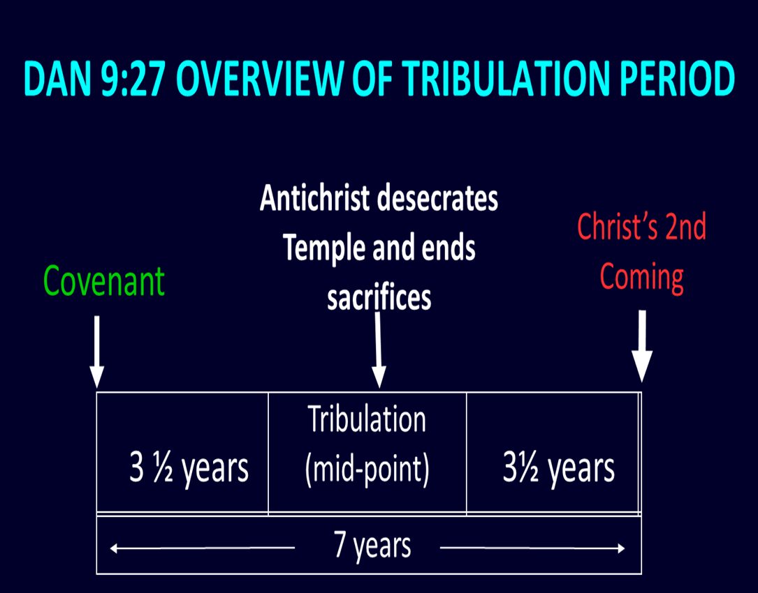

Slide 42
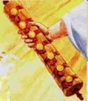
1st Six Seals (Revelation 6)
SEAL 1 – 6:1-2 – Advent of antichrist
SEAL 2 – 6:3-4 – War
SEAL 3 – 6:5-6 – Famine
SEAL 4 – 6:7-8 – Death
SEAL 5 – 6:9-11 – Martyrdoms
SEAL 6 – 6:12-17 – Cosmic disturbances

Slide 43
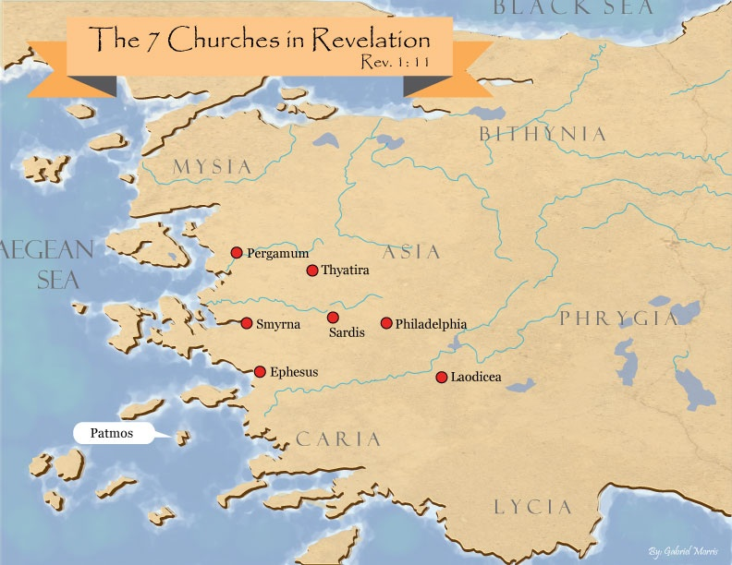
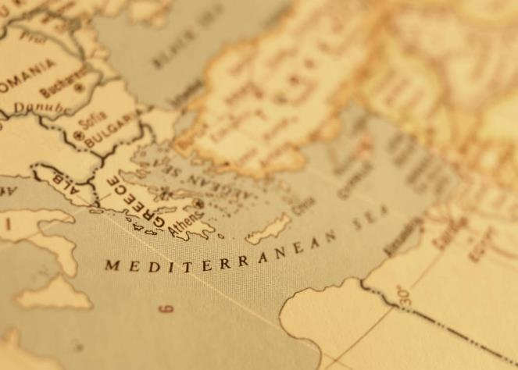

Slide 44
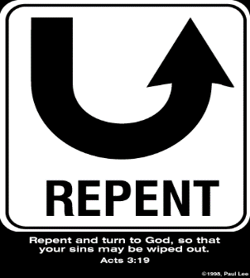
Revelation 2:4-5
Apostasy
“⁴ But I have this against you, that you have left your first love. ⁵ Therefore remember from where you have fallen, and repent and do the deeds you did at first; or else I am coming to you and will remove your lampstand out of its place—unless you repent.”

Slide 45

1 Corinthians 15:52
“in a moment [atomos], in the twinkling of an eye, at the last trumpet; for the trumpet will sound, and the dead will be raised imperishable, and we will be changed.”

Slide 46

Instantaneous
(1 Cor 15:52)
Twinkling of an eye
Flash or moment
Split second
Atomos (Greek) = atom (English)

Slide 47

A.T. Robertson
Word Pictures (2 Thessalonians 2:3)
“…the use of the definite article (ἡ [hē]) seems to mean that Paul had spoken to the Thessalonians about it.”

Slide 48
2 Thessalonians 2:1
“Now we request you, brethren, with regard to the coming of our Lord Jesus Christ and our gathering together to Him.”

Slide 49
1 Thessalonians 1:10
“and to wait for His Son from heaven, whom He raised from the dead, that is Jesus, who rescues (rhyomai) us from (ek) the wrath (orgē) to come..”

Slide 50

1 Thessalonians 4:17
“. . .heaven with a shout, with the voice of the archangel and with the trumpet of God, and the dead in Christ will rise first. ¹⁷ Then we who are alive and remain will be caught up together with them in the clouds to meet the Lord in the air, and so we shall always be with the Lord. ¹⁸ Therefore comfort one another with these words."

Slide 51
10 Reasons Favoring Physical Departure
There have always been doctrinal departures
2 Thess. was an early letter
The definite article before apostasia
Noun apostasia can refer to physical departure
Verb aphistēmi can refer to physical departure

Slide 52
Acts 21:21
“and they have been told about you, that you are teaching all the Jews who are among the Gentiles to forsake [apostasia] Moses, telling them not to circumcise their children nor to walk according to the customs.”

Slide 53
THE APOSTASIA
2 Thessalonians 2:3a | Acts 21:21
Pauline authorship | Lukan authorship
Paul speaking | Paul not speaking (v. 20)
Mosaic Law not mentioned | Departure from the Mosaic Law
Epistolary genre | Narrative genre
Definite article | No definite article

Slide 54


Slide 55
George Gunn
John 14:1-3 – The Father’s House: Are We There Yet?, 30. www.pre-trib.org
“I ran out of ingredients for the salad, so I decided to make a quick run down to the store. While at the store, I left the car engine running while I made my purchase, thinking that I would be right out again. However, while I was in the store, I ran into my good friend Edward who was running for county supervisor. This resulted in my having to endure a somewhat long-winded rundown on how his campaign was running. Finally, fearing that my car would run out of gas, I ran with great haste out to the parking lot and returned home with the car surely running only on fumes.”

Slide 56
Illegitimate Totality Transfer
D. A. Carson, Exegetical Fallacies, 2nd ed. (Grand Rapids, MI: Baker Academic, 1996), 60-61.
“Unwarranted adoption of an expanded semantic field: The fallacy in this instance lies in the supposition that the meaning of a word in a specific context is much broader than the context itself allows and may bring with it the word’s entire semantic range. This step is sometimes called illegitimate totality transfer.”

Slide 57

Definition of “Apostasy”
apos = away from
histēmi = to stand
Apostasy = to stand away from
Apostasy = a departure
A departure from what?
  From previously known truth
  Physically from something

Slide 58
Entries for Apostasia in Liddell & Scott
Rebellion against God
Apostasy
Departure
Disappearance
Distance
Henry Liddell & Henry Scott, A Greek English Lexicon (Oxford: Oxford University Press, 1940), 218.

Slide 59
Gordon Lewis
Gordon R. Lewis, "Biblical Evidence for Pretribulationism," Bibliotheca Sacra 125, no. 499 (1968): 218.
“The…obvious meaning of…the noun is justified…by classical Greek usage. Liddel and Scott, in their authoritative lexicon of classical Greek, list as the second meaning of the noun, departure or disappearance. And they cite a commentary on Aristotle’s Meteora where the stiffening of a material is said to be caused by apostasia of water from it. One could hardly find a better analogy for the rapture than evaporation.”

Slide 60
Entries for Apostasia in Lampe’s A Patristic Greek Lexicon
Revolt
Defection
Apostasy from paganism, Judaism, Christianity, orthodoxy
Divorce
Departure
Standing aloof
G. W. H. Lampe, A Patristic Greek Lexicon (Oxford: Clarnedon Press, 1961), 208.

Slide 61
H. Wayne House
"Apostasia in 2 Thessalonians 2:3: Apostasy of Rapture?," in When the Trumpet Sounds: Today's Foremost Authorities Speak out on End-Time Controversies, ed. Thomas Ice and Timothy Demy (Eugene, OR: Harvest House, 1995), 273.
“The noun form allows for apostasia as a simple departure in the classical period, proved by examples from Liddell and Scott...If one says that this is not important because the meaning is only classical or ancient and thus lost its meaning by the time of the New Testament, then I may turn to the same root meaning of apostasia in the patristic era immediately following the New Testament period, as indicated in the definitions for the noun form in Lampe's Patristic Greek Lexicon. Although the noun used in the sense of spatial departure is not the normal meaning…during New Testament times, the word is found with this meaning in time periods before and after the New Testament era, and it is likely to have been understood this way at least sometimes.”

Slide 62
2 Chronicles 29:19 (LXX)
LXX: καὶ πάντα τὰ σκεύη ἃ ἐμίανεν Αχαζ ὁ βασιλεὺς ἐν τῇ βασιλείᾳ αὐτοῦ ἐν τῇ ἀποστασίᾳ αὐτοῦ ἡτοιμάκαμεν καὶ ἡγνίκαμεν ἰδού ἐστιν ἐναντίον τοῦ θυσιαστηρίου κυρίου
KJV: “Moreover, all the vessels, which king Ahaz in his reign did cast away in his transgression, have we prepared and sanctified, and, behold, they are before the altar of the LORD.”
NASB (1995): “Moreover, all the utensils which King Ahaz had discarded during his reign in his unfaithfulness, we have prepared and consecrated; and behold, they are before the altar of the LORD.”
NIV: “We have prepared and consecrated all the articles that King Ahaz removed in his unfaithfulness while he was king. They are now in front of the LORD’s altar.”

Slide 63
2 Chronicles 28:24 (LXX)
LXX: καὶ ἀπέστησεν Ἀχὰζ τὰ σκεύη οἴκου Κυρίου καὶ κατέκοψεν αὐτά, καὶ ἔκλεισεν τὰς θύρας οἴκου Κυρίου, καὶ ἐποίησεν ἑαυτῷ θυσιαστήρια ἐν πάσῃ γωνίᾳ,
KJV: “And Ahaz gathered together the vessels of the house of God, and cut in pieces the vessels of the house of God, and shut up the doors of the house of the LORD, and he made him altars in every corner of Jerusalem.”
NASB95: “Moreover, when Ahaz gathered together the utensils of the house of God, he cut the utensils of the use of God in pieces; and he closed the doors of the house of the LORD and made altars for himself in every corner of Jerusalem.”
NIV: “Ahaz gathered together the furnishings from the temple of God and cut them in pieces. He shut the doors of the LORD’s temple and set up altars at every street corner in Jerusalem.”

Slide 64
10 Reasons Favoring Physical Departure
There have always been doctrinal departures
2 Thess. was an early letter
The definite article before apostasia
Noun apostasia can refer to physical departure
Verb aphistēmi can refer to physical departure

Slide 65
Gordon Lewis
Gordon R. Lewis, "Biblical Evidence for Pretribulationism," Bibliotheca Sacra 125, no. 499 (1968): 218.
“The verb may mean to remove spatially. There is little reason then to deny that the noun can mean such a spatial removal or departure. Since the noun is used only one other time in the New Testament of apostasy from Moses (Acts 21:21), we can hardly conclude that its Biblical meaning is necessarily determined. The verb is used fifteen times in the New Testament.”

Slide 66
New Testament Meanings of Aphistēmi
15 New Testament uses
Spiritual departure – Luke 8:13; 1 Tim. 4:1; Heb. 3:12
Physical departure – Luke 2:37; 4:13; 13:27; Acts 5:37-38; 12:10; 13:13; 15:38; 19:9; 22:29; 2 Cor. 12:8; 2 Tim. 2:19

Slide 67
New Testament Meanings of Aphistēmi
15 New Testament uses
Spiritual departure – Luke 8:13; 1 Tim. 4:1; Heb. 3:12
Physical departure – Luke 2:37; 4:13; 13:27; Acts 5:37-38; 12:10; 13:13; 15:38; 19:9; 22:29; 2 Cor. 12:8; 2 Tim. 2:19

Slide 68
1 Timothy 4:1
“But the Spirit explicitly says that in later times some will fall away [aphistēmi] from the faith, paying attention to deceitful spirits and doctrines of demons.”

Slide 69
Hebrews 3:12
“ Take care, brethren, that there not be in any one of you an evil, unbelieving heart that falls away [aphistēmi] from the living God.”

Slide 70
New Testament Meanings of Aphistēmi
15 New Testament uses
Spiritual departure – Luke 8:13; 1 Tim. 4:1; Heb. 3:12
Physical departure – Luke 2:37; 4:13; 13:27; Acts 5:37-38; 12:10; 13:13; 15:38; 19:9; 22:29; 2 Cor. 12:8; 2 Tim. 2:19

Slide 71
Root or Cognate Fallacy
D. A. Carson, Exegetical Fallacies, 2nd ed. (Grand Rapids, MI: Baker Academic, 1996), 28.
“One of the most enduring of errors, the root fallacy presupposes that every word actually has a meaning bound up with its shape or its components. In this view, meaning is determined by etymology; that is, by the root or roots of a word. How many times have we been told that because the verbal cognate of ἀπόστολος (apostle) is ἀποστέλλω (I send), the root meaning of ‘apostle’ is ‘one who is sent’?”

Slide 72
10 Reasons Favoring Physical Departure
Extended context favors physical departure
Immediate context favors physical departure
2 Thess. 2:2 is a review course
Early Bible translations favor physical departure
Physical departure is held by credible scholars

Slide 73
Unique Characteristics of 1-2 Thessalonians
Small amount of time in between planting of the church and the first letter to the church
Every chapter ends with a reference to the Second Advent

Slide 74
1 Thessalonians 1:10
“and to wait for His Son from heaven, whom He raised from the dead, that is Jesus, who rescues (rhyomai) us from (ek) the wrath (orgē) to come..”

Slide 75
1 Thessalonians 4:17
“. . .heaven with a shout, with the voice of the archangel and with the trumpet of God, and the dead in Christ will rise first. ¹⁷ Then we who are alive and remain will be caught up together with them in the clouds to meet the Lord in the air, and so we shall always be with the Lord. ¹⁸ Therefore comfort one another with these words."

Slide 76
10 Reasons Favoring Physical Departure
Extended context favors physical departure
Immediate context favors physical departure
2 Thess. 2:2 is a review course
Early Bible translations favor physical departure
Physical departure is held by credible scholars

Slide 77
2 Thessalonians 2:1
“Now we request you, brethren, with regard to the coming of our Lord Jesus Christ and our gathering together to Him.”

Slide 78
2 Thessalonians 2:1-12
Problem (2:1-2)
Prerequisites for the Day of the Lord (2:3-12)
  The apostasy (2:3a)
  Advent of the lawless one (2:3b-4)
  Removal of the restrainer (2:5-7)
  Destruction of the lawless one (2:8-9)
  Destruction of lawless one’s followers (2:10-12)

Slide 79

2 Thessalonians 2:6-7
⁶And you know what restrains [katechō; neuter] him now, so that in his time he will be revealed. ⁷For the mystery of lawlessness is already at work; only he who now restrains [katechō; masculine] will do so until he is taken out of the way.

Slide 80

Restrainer? (2:6-7)
Rome?
Satan?
Government?
Michael?
Spirit?

Slide 81
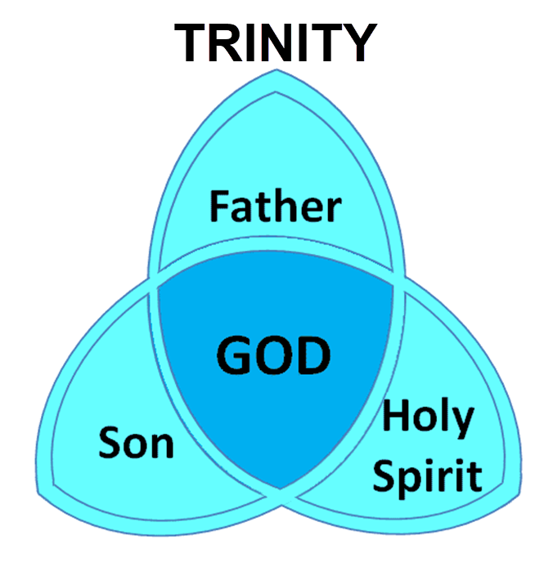

Slide 82

3 Reasons Why the Restrainer is the Holy Spirit
(2 Thessalonians 2:6-7)
The Holy Spirit is omnipotent (2 Thess. 2:9)
The Holy Spirit is active in the world (Gen. 6:3; John 16:7-11)
The Holy Spirit view handles well the switch in gender from the neuter (vs. 6) to the masculine (vs. 7)

Slide 83

2 Thessalonians 2:9
“that is, the one whose coming is in accord with the activity of Satan, with all power and signs and false wonders.”

Slide 84
3 Reasons Why the Restrainer is the Holy Spirit
(2 Thessalonians 2:6-7)
The Holy Spirit is omnipotent (2 Thess. 2:9)
The Holy Spirit is active in the world (Gen. 6:3; John 16:7-11)
The Holy Spirit view handles well the switch in gender from the neuter (vs. 6) to the masculine (vs. 7)

Slide 85
Genesis 6:1-3
“¹ Now it came about, when men began to multiply on the face of the land, and daughters were born to them, ² that the sons of God saw that the daughters of men were beautiful; and they took wives for themselves, whomever they chose. ³ Then the Lord said, “My Spirit shall not strive with man forever, because he also is flesh; nevertheless his days shall be one hundred and twenty years.”

Slide 86
John 16:7-11
“⁷ But I tell you the truth, it is to your advantage that I go away; for if I do not go away, the Helper will not come to you; but if I go, I will send Him to you. ⁸ And He, when He comes, will convict the world concerning sin and righteousness and judgment; ⁹ concerning sin, because they do not believe in Me; ¹⁰ and concerning righteousness, because I go to the Father and you no longer see Me; ¹¹ and concerning judgment, because the ruler of this world has been judged.”

Slide 87
3 Reasons Why the Restrainer is the Holy Spirit
(2 Thessalonians 2:6-7)
The Holy Spirit is omnipotent (2 Thess. 2:9)
The Holy Spirit is active in the world (Gen. 6:3; John 16:7-11)
The Holy Spirit view handles well the switch in gender from the neuter (vs. 6) to the masculine (vs. 7)

Slide 88
2 Thessalonians 2:6-7
⁶And you know what restrains [katechō; neuter] him now, so that in his time he will be revealed. ⁷For the mystery of lawlessness is already at work; only he who now restrains [katechō; masculine] will do so until he is taken out of the way.

Slide 89
John 14:16-17
¹⁶ I will ask the Father, and He will give you another Helper, that He may be with you forever; ¹⁷ that is the Spirit of truth, whom the world cannot receive, because it does not see Him or know Him, but you know Him because He abides with you and will be in you.

Slide 90
Restrainer Must First be Removed
Restrainer holds back the Antichrist (2 Thess 2:6-7)
Restrainer = the omnipotent Holy Spirit (2 Thess 2:9)
Holy Spirit permanently indwells all Christians (John 14:16; Rom 8:9)
Sprit indwelt Christians must first be removed prior to the Antichrist's advent

Slide 91
Restrainer Must First be Removed
Restrainer holds back the Antichrist (2 Thess 2:6-7)
Restrainer = the omnipotent Holy Spirit (2 Thess 2:9)
Holy Spirit permanently indwells all Christians (John 14:16; Rom 8:9)
Sprit indwelt Christians must first be removed prior to the Antichrist's advent

Slide 92

John 14:16-17
¹⁶ I will ask the Father, and He will give you another Helper, that He may be with you forever; ¹⁷ that is the Spirit of truth, whom the world cannot receive, because it does not see Him or know Him, but you know Him because He abides with you and will be in you.

Slide 93
Restrainer Must First be Removed
Restrainer holds back the Antichrist (2 Thess 2:6-7)
Restrainer = the omnipotent Holy Spirit (2 Thess 2:9)
Holy Spirit permanently indwells all Christians (John 14:16; Rom 8:9)
Sprit indwelt Christians must first be removed prior to the Antichrist's advent

Slide 94
10 Reasons Favoring Physical Departure
Extended context favors physical departure
Immediate context favors physical departure
2 Thess. 2:2 is a review course
Early Bible translations favor physical departure
Physical departure is held by credible scholars

Slide 95
1 Thessalonians 4:16-18
¹⁶ For the Lord Himself will descend from heaven with a shout, with the voice of the archangel and with the trumpet of God, and the dead in Christ will rise first. ¹⁷ Then we who are alive and remain will be caught up [harpazō] together with them in the clouds to meet the Lord in the air, and so we shall always be with the Lord. ¹⁸ Therefore comfort one another with these words.

Slide 96
2 Thessalonians 2:3
“Let no one in any way deceive you, for it will not come unless the apostasy [apostasia] comes first, and the man of lawlessness is revealed, the son of destruction.”

Slide 97

2 Thessalonians 2:5
“Do you not remember that while I was still with you, I was telling you these things?”

Slide 98

Paul’s Various Rapture Terms
parousia | 2 Thess. 2:1
episynagōgē | 2 Thess. 2:1
apokalypsis | 1 Cor. 1:7
epiphaneia | Titus 2:13
rhyomai | 1 Thess. 1:10
harpazō | 1 Thess. 4:17
apostasia | 2 Thess. 2:3a

Slide 99
10 Reasons Favoring Physical Departure
Extended context favors physical departure
Immediate context favors physical departure
2 Thess. 2:2 is a review course
Early Bible translations favor physical departure
Physical departure is held by credible scholars

Slide 100
“Departing First” or “Falling Away”
Year | Bible | Translation
1384 | Wycliffe Bible | Departynge First
1526 | Tyndale Bible | Departynge First
1535 | Coverdale Bible | Departynge First
1539 | Crammer Bible | Departing First
1576 | Breeches Bible | Departing First
1583 | Beeza Bible | Departing First
1608 | Geneva Bible | Departing First
1576 | Rheims Bible | The Protestant “Revolt”
1611 | King James V. | Falling Away
House, When the Trumpet Sounds, p. 270.

Slide 101
2 Thessalonians 2:3
Rheims Bible 1576
“Let no man deceive you by any means, for unless there come a revolt [apostasia] first, and the man of sin be revealed, the son of perdition.”

Slide 102

Matthew 3:1-2
“Now in those days John the Baptist came, preaching in the wilderness of Judea, saying, ‘Repent [metanoeō], for the kingdom of heaven is at hand.”

Slide 103
Matthew 3:1-2
Rheims Bible 1576
“AND in those days cometh John the Baptist preaching in the desert of Judea. And saying: Do penance: for the kingdom of heaven is at hand.”

Slide 104
Thomas Ice
“The ‘Departure’ in 2 Thessalonians 2:3,” online: www.pre-trib.org, accessed 7 May 2017, 2.
“Most scholars say that no one knows the reason for the translation shift. However, a plausible theory has been put forth by Martin Butalla in his Master of Theology thesis produced at Dallas Theology Seminary in 1998. It appears that the Catholic translation into English from Jerome’s Latin Vulgate known as the Rheims Bible (1576) was the first to break the translation trend. “Apostasia was revised from ‘the departure’ to ‘the Protestant Revolt,’” explains Butalla. “Revolution is the terminology still in use today when Catholicism teaches the history of the Protestant Reformation. Under this guise, apostasia would refer to a departure of Protestants from the Catholic Church.” The Catholic translators appear eager to engage in polemics against the Reformation by even allowing it to impact Bible translation.”

Slide 105

NKJV, NIV, RSV, ASV, JB, NASB
“apostasy”
“falling away”
“revolt”
“rejection”
“rebellion”

Slide 106
2 Thessalonians 2:3
“Let no one in any way deceive you, for it will not come unless the apostasy [apostasia; departure] comes first, and the man of lawlessness is revealed, the son of destruction.”

Slide 107
10 Reasons Favoring Physical Departure
Extended context favors physical departure
Immediate context favors physical departure
2 Thess. 2:2 is a review course
Early Bible translations favor physical departure
Physical departure is held by credible scholars

Slide 108

Physical Departure Adherents
Kenneth Wuest |  | Paul Lee Tan*
E. Schuyler English |  | Arnold Fruchtenbaum*
J. Dwight Pentecost |  | Tim LaHaye
H. Wayne House* |  | Thomas Ice
Stanley Ellison |  | Don Stewart
J.S. Mabie |  | Robert Thieme
Allen McRae |  | Gordon Olson*
Gordon Lewis |  | J. Vernon McGee*
Henry Morris* |  | Jimmy DeYoung*
John. R. Rice |  | David Hocking
David Olander* |  | Jimmy Swaggart*
J. Carl Laney* |  | Chuck Smith*
Grant Jeffrey |  | Myron Houghton*

Slide 109
2 Thessalonians 2:3a
Why Physical Departure?
  Inadequacy of spiritual departure interpretations
  Reasons favoring physical departure
  Answering the objections

Slide 110

Answering Objections to the Physical Departure View
Greek from the Koine period?
Subtraction from the Last Days will be characterized by continual apostasy?
Rapture is passive and apostasy is active?
Incongruence with verse 1?
Paul is re-assuring the Thessalonians that they had not already missed the rapture; therefore, it would be incomprehensible to read, “the rapture cannot have happened unless the rapture happens first”

Slide 111
Answering Objections to the Physical Departure View
Greek from the Koine period?
Subtraction from the Last Days will be characterized by continual apostasy?
Rapture is passive and apostasy is active?
Incongruence with verse 1?
Paul is re-assuring the Thessalonians that they had not already missed the rapture; therefore, it would be incomprehensible to read, “the rapture cannot have happened unless the rapture happens first”

Slide 112
2 Thessalonians 2:3
“Let no one in any way deceive you, for it will not come unless the apostasy [apostasia] comes first [prōton], and the man of lawlessness is revealed, the son of destruction.”

Slide 113
ORDER OF PAUL’S LETTERS | ORDER OF PAUL’S LETTERS
1. | Galatians | A.D. 49
2. | 1‒2 Thessalonians | A.D. 51
3. | 1‒2 Corinthians | A.D. 56
4. | Romans | A.D. 57
5. | Ephesians, Colossians, Philemon, Philippians | A.D. 60‒62
6. | 1 Timothy, Titus | A.D. 62‒66
7. | 2 Timothy | A.D. 67

Slide 114
Answering Objections to the Physical Departure View
Greek from the Koine period?
Subtraction from the Last Days will be characterized by continual apostasy?
Rapture is passive and apostasy is active?
Incongruence with verse 1?
Paul is re-assuring the Thessalonians that they had not already missed the rapture; therefore, it would be incomprehensible to read, “the rapture cannot have happened unless the rapture happens first”

Slide 115
D. Edmond Hiebert
The Thessalonian Epistles. Chicago: Moody Press, 1971. Page 306
"Nowhere else does the Scripture speak of the rapture as 'the departure.' A departure denotes an act on the part of the individual or company departing. But the rapture is not an act of departure on the part of the saints. In the rapture the church is passive, not active. At the rapture, the church is 'caught up' or 'snatched away,' an event wherein the Lord acts to transport believers from earth into His presence (1 Thess. 4:16-17). Everything that takes place with the believers at the rapture is initiated by the Lord and done by Him.”

Slide 116

Luke 24:51
“While He was blessing them, He parted from them and was carried up into heaven.”

Slide 117
Answering Objections to the Physical Departure View
Greek from the Koine period?
Subtraction from the Last Days will be characterized by continual apostasy?
Rapture is passive and apostasy is active?
Incongruence with verse 1?
Paul is re-assuring the Thessalonians that they had not already missed the rapture; therefore, it would be incomprehensible to read, “the rapture cannot have happened unless the rapture happens first”

Slide 118
2 Thessalonians 2:1
“Now we request you, brethren, with regard to the coming [parousia] of our Lord Jesus Christ and our gathering [episynagōgē] together to Him.”

Slide 119
2 Thessalonians 2:3
“Let no one in any way deceive you, for it will not come unless the apostasy [apostasia] comes first, and the man of lawlessness is revealed, the son of destruction.”

Slide 120

D. Edmond Hiebert
The Thessalonian Epistles. Chicago: Moody Press, 1971. Page 306
"Paul has just referred to the rapture as 'our gathering together unto him' (v. 1); why then should he now use this unlikely term to mean the same thing?”

Slide 121
Paul’s Various Rapture Terms
parousia | 2 Thess. 2:1
episynagōgē | 2 Thess. 2:1
apokalypsis | 1 Cor. 1:7
epiphaneia | Titus 2:13
rhyomai | 1 Thess. 1:10
harpazō | 1 Thess. 4:17
apostasia | 2 Thess. 2:3a

Slide 122
Answering Objections to the Physical Departure View
Greek from the Koine period?
Subtraction from the Last Days will be characterized by continual apostasy?
Rapture is passive and apostasy is active?
Incongruence with verse 1?
Paul is re-assuring the Thessalonians that they had not already missed the rapture; therefore, it would be incomprehensible to read, “the rapture cannot have happened unless the rapture happens first”

Slide 123
2 Thessalonians 2:2-3 (NKJV)
“² not to be soon shaken in mind or troubled, either by spirit or by word or by letter, as if from us, as though the day of Christ [rapture] had come. ³ Let no man deceive you by any means: for that day [rapture] shall not come, except there come a falling away [rapture] first, and that man of sin be revealed, the son of perdition.”

Slide 124
2 Thessalonians 2:3 (NASB)
“² that you not be quickly shaken from your composure or be disturbed either by a spirit or a message or a letter as if from us, to the effect that the day of the Lord [the tribulation period] has come. ³ Let no one in any way deceive you, for it [the tribulation period] will not come unless the apostasy [apostasia] comes first, and the man of lawlessness is revealed, the son of destruction.”

Slide 125

Genesis 1:5
“God called the light day, and the darkness He called night. And there was evening and there was morning, one day [yôm].”
o

Slide 126
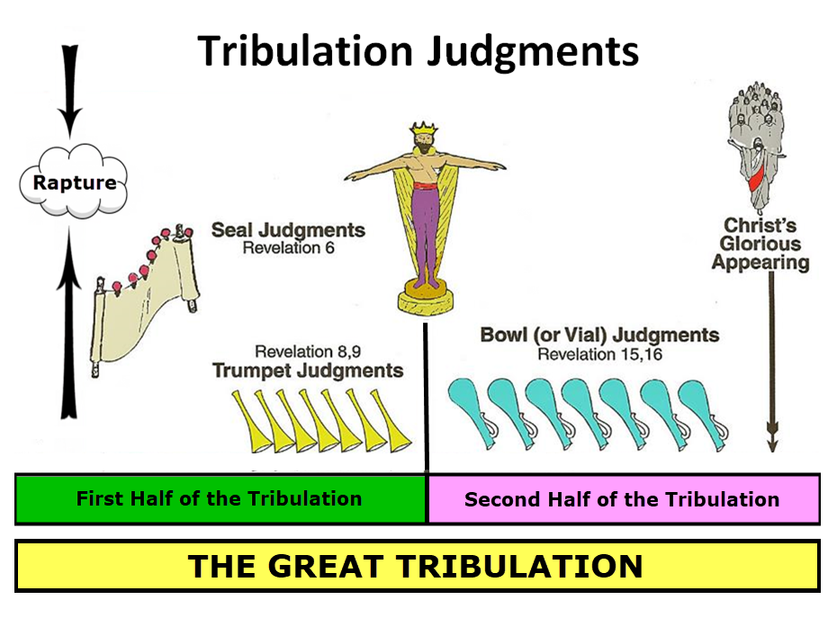

Slide 127
2 Thessalonians 2:3 (NASB)
“² that you not be quickly shaken from your composure or be disturbed either by a spirit or a message or a letter as if from us, to the effect that the day of the Lord [the tribulation period] has come. ³ Let no one in any way deceive you, for it [the tribulation period] will not come unless the apostasy [apostasia] comes first, and the man of lawlessness is revealed, the son of destruction.”

Slide 128
1 Thessalonians 5:2-3 (NKJV)
“² For you yourselves know perfectly that the day of the Lord so comes as a thief in the night. ³ For when they say, “Peace and safety!” then sudden destruction comes upon them, as labor pains upon a pregnant woman. And they shall not escape.”

Slide 129
2 Thessalonians 2:3a
Why Physical Departure?
  Inadequacy of spiritual departure interpretations
  Reasons favoring physical departure
  Answering the objections

Slide 130
2 Thessalonians 2:3
“Let no one in any way deceive you, for it will not come unless the apostasy [apostasia; departure] comes first, and the man of lawlessness is revealed, the son of destruction.”

