Slide 1

Biblical World News
365 Days a Year
http://watch.org

Slide 2
The Finger of God - J.C. Ryle, MA
Who sent the flood on the world in the days of Noah (Genesis 6:17)? It was God.
Who sent the famine in the days of Joseph (Genesis 41:25)? It was God.
Who sent the plague on Egypt, and specially the murrain on the cattle (Exodus 7:5; 9:3)? It was God.
Who sent disease on the Philistines, when the ark was among them (1 Samuel 5:7; 6:3-7)? It was God.
Who sent the pestilence in the days of David (2 Samuel 24:15)? It was God.
Who sent the famine in the days of Elisha (2 Kings 8:1)? It was God.
Who sent the stormy wind and tempest in the days of Jonah (Jonah 1:4)? It was God.

Slide 3


Slide 4
‘Eye to Eye’ –
Facing the Consequences of Dividing Israel
Covering Bush, Clinton, Bush, Obama and Trump administrations
576 pages from the Perfect Storm to Hurricane Harvey
127 record-setting catastrophes and events
12 largest property insurance events in US history
The two largest terrorist events in US history
19 of the 20 costliest hurricanes in US history
5 of the 7 largest tornado outbreaks in US history

Slide 5

$7 a month - WilliamKoenig.com

Slide 6
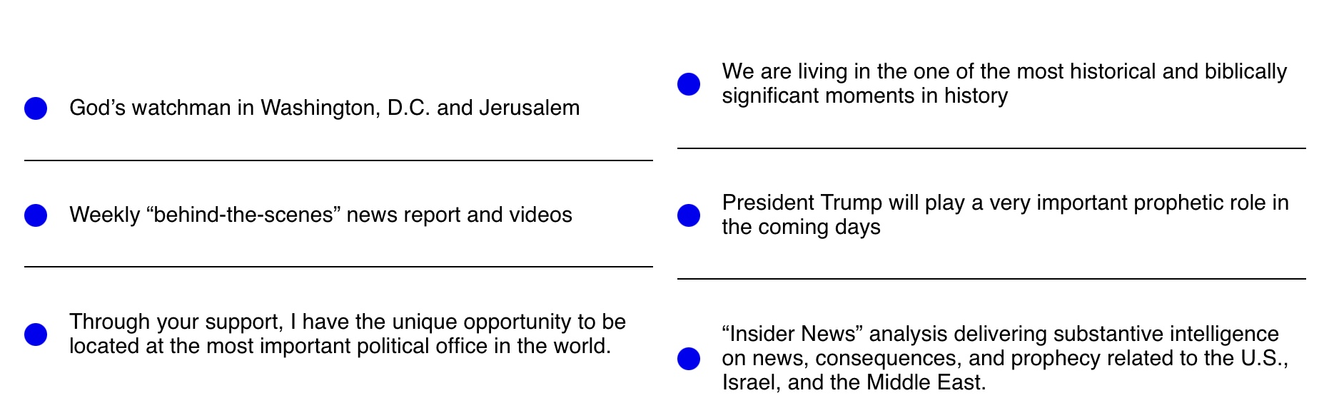

Slide 7

The Hague, The Netherlands –
July 3-4, 2024

Slide 8

Former vice mayor of Rotterdam, The Netherlands with Tania and me – July 3, 2024

Slide 9
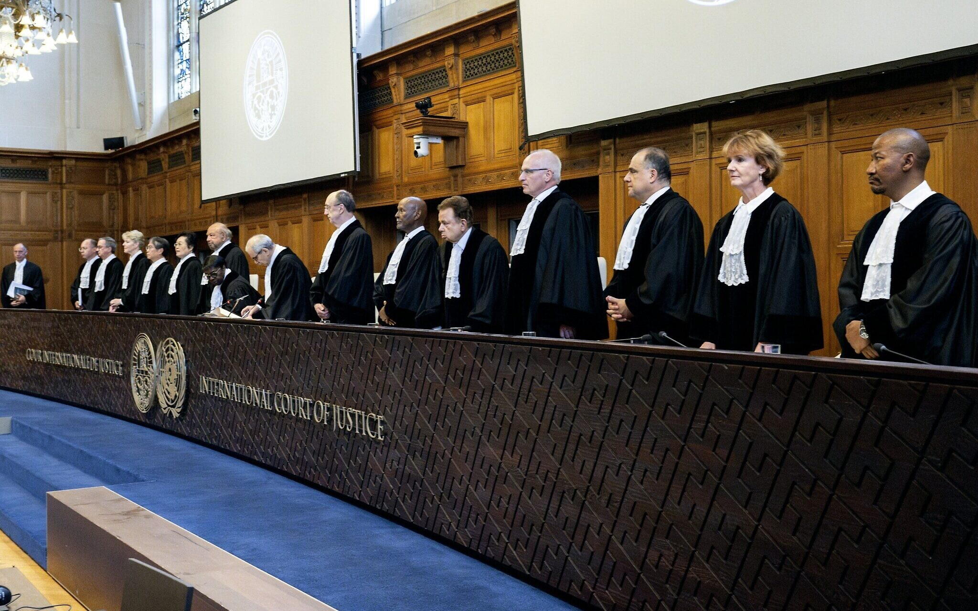
International Court of Justice
The International Court of Justice (ICJ) issued an advisory opinion on July 19, 2024, that Israel's presence in the Occupied Palestinian Territory (OPT) is unlawful and must end as soon as possible. The ICJ's opinion included the following findings:
Israel is responsible for apartheid and racial segregation against Palestinians
Israel's occupation of the OPT is illegal
Israel must provide reparations to Palestinians
All states and international organizations, including the UN, must not recognize the legality of Israel's presence in the OPT
The UN should consider how to end Israel's presence in the OPT

Slide 10
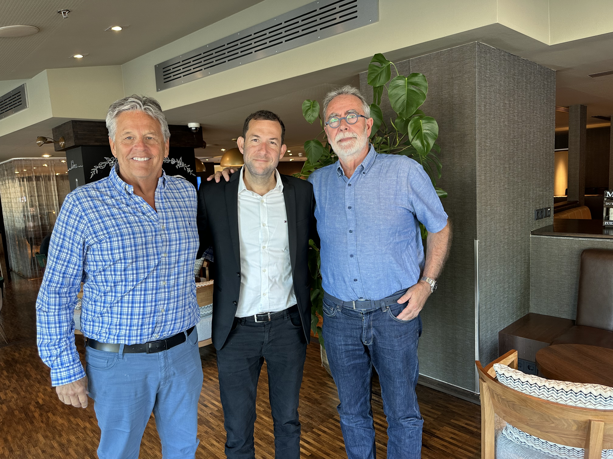
Governor Yossi Dagan leader of Shomron Regional, Samaria, Israel, with Jack van der Tang and me
Amsterdam, The Netherlands - July 24, 2024

Slide 11
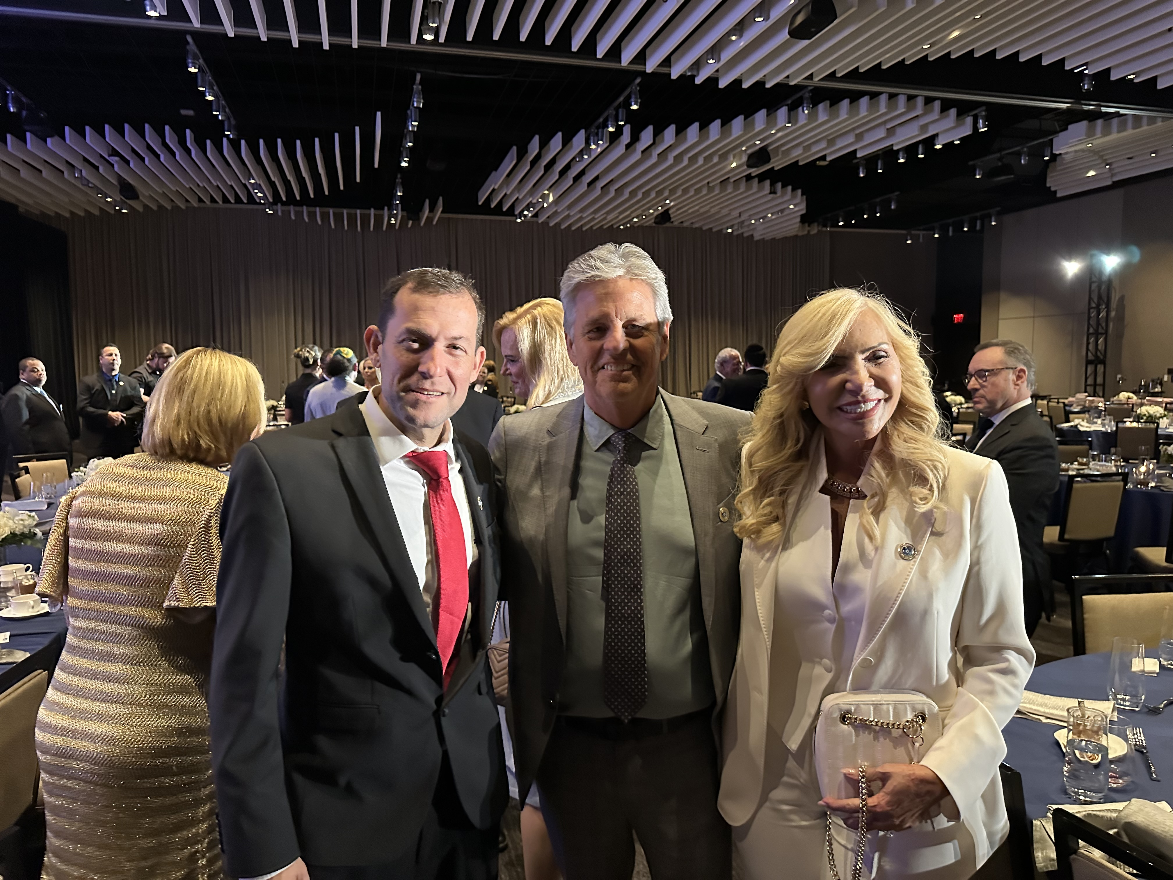
Governor Yossi Dagan leader of Shomron Regional, Samaria, Israel with Tania and me – Dallas, Sept 12, 2024

Slide 12
Trump’s Middle East Envoys, four billionaires

Slide 13
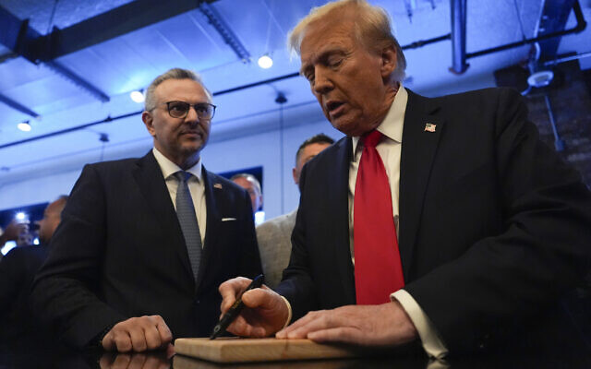
Trump in-law Massad Boulos
setting up contacts with Palestinian’s Abbas
Dearborn, Michigan on November 1, 2024.

Slide 14

Massad Boulos, Trump’s new Middle East adviser, touts roadmap to Palestinian state

Slide 15
Massad Boulos, President-elect Donald Trump’s advisor on Middle Eastern and Arab affairs, said “I think the issue of a roadmap that would lead to a Palestinian state is an important part of the discussions between the United States and Saudi Arabia,” Boulos said in a wide-ranging interview last week with Le Point, a French magazine. “It is certainly a very important point.”

Slide 16
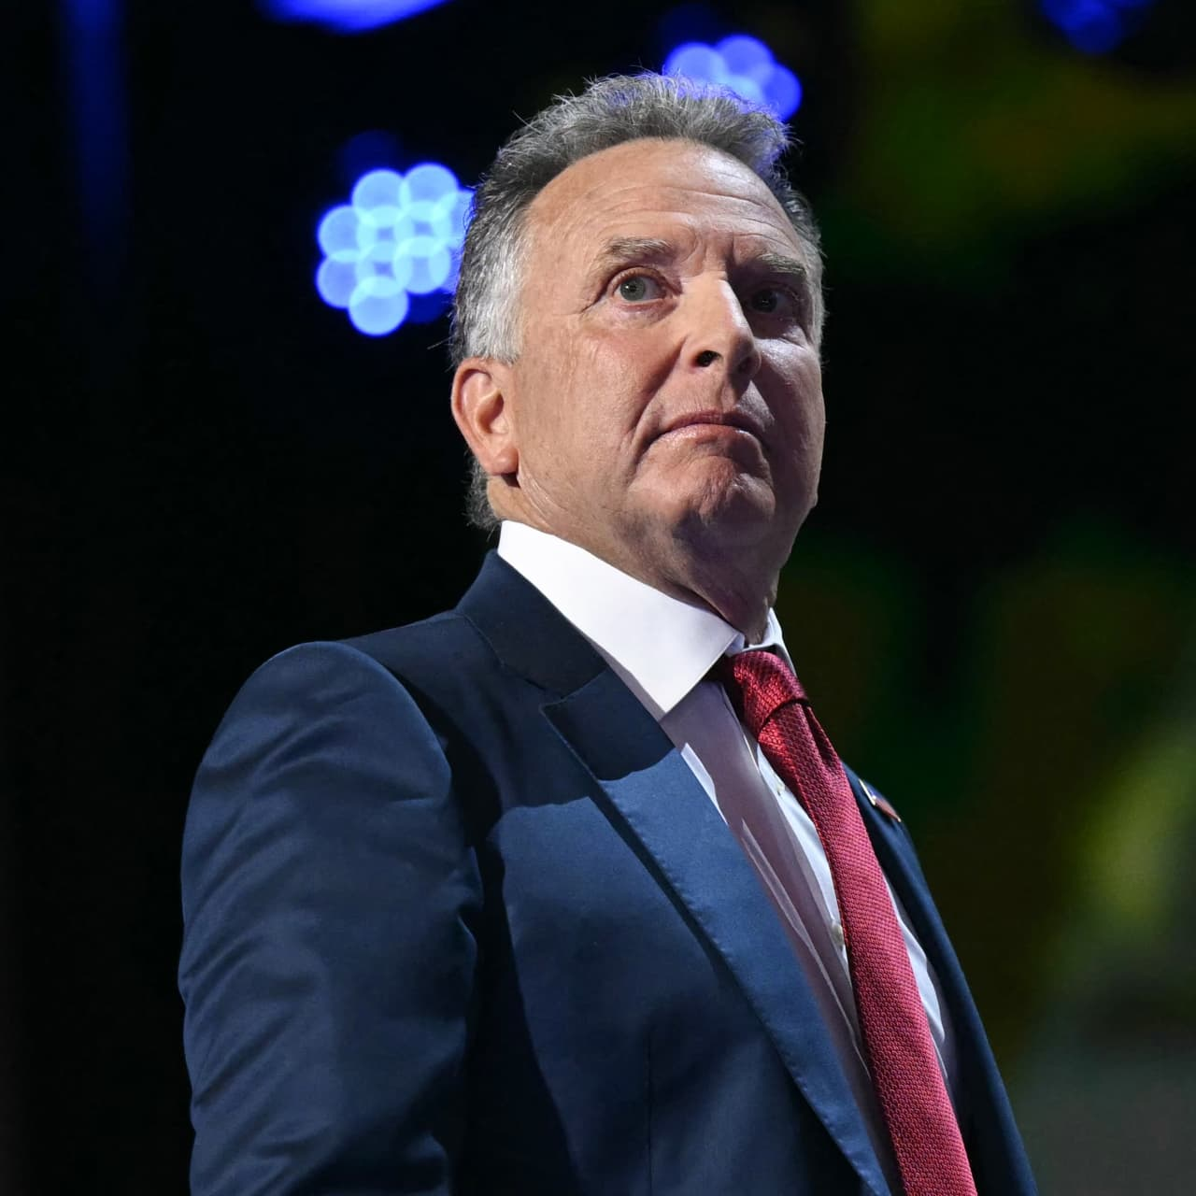
Steve Witkoff – Trump’s Middle East Envoy
Last year Witkoff sold Manhattan’s Park Lane Hotel to the Qatari Investment Authority,
the country’s sovereign-wealth fund, for $623 million. Abu Dhabi’s investment fund was also involved.

Slide 17
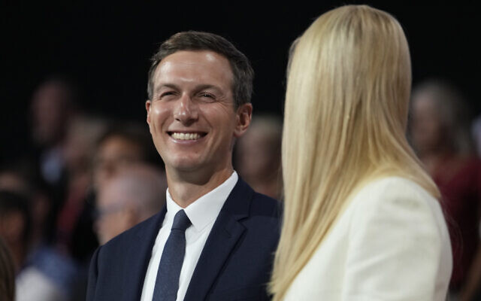
Kushner said expected to play key role in Trump’s Mideast policy

Slide 18

Elon Musk Met With Iran’s U.N. Ambassador
November 11, 2024

Slide 19
Political figures and the Middle East

Slide 20

Mike Huckabee
US Ambassador to Israel Nominee

Slide 21

Marco Rubio
Secretary of State Nominee

Slide 22

Elise Stefanik
US U.N. Ambassador Nominee

Slide 23

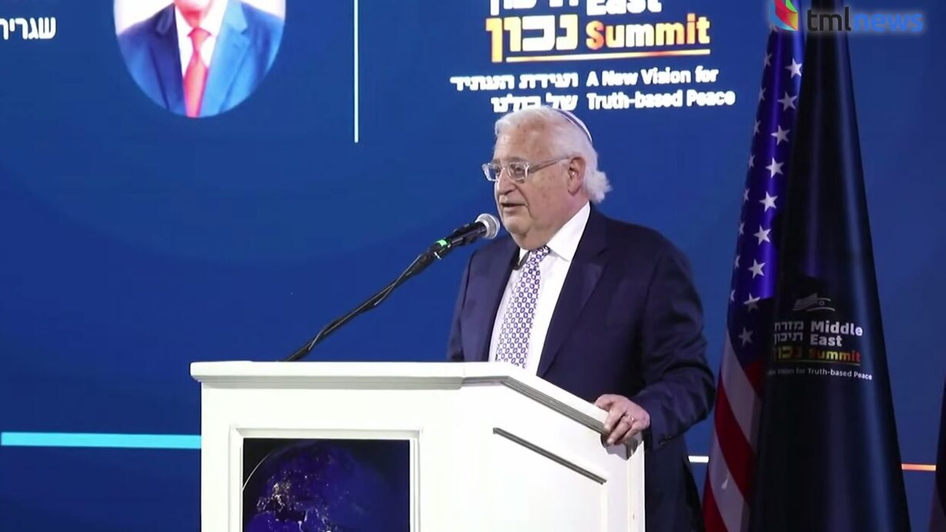
Former US Ambassador to Israel David Friedman

Slide 24
The infernal Qatari strategy:
While Donald Trump threatens the enemies of Israel and civilization, Britain licks their sandals.

Slide 25

Trump demands immediate release of Oct. 7 hostages, says otherwise there will be 'HELL TO PAY'

Slide 26
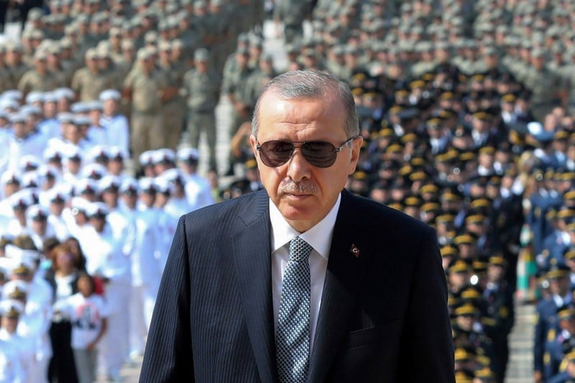
Erdogan Gets His ‘Leader of the
Muslim World’ Moment – Dec. 9, 2024

Slide 27
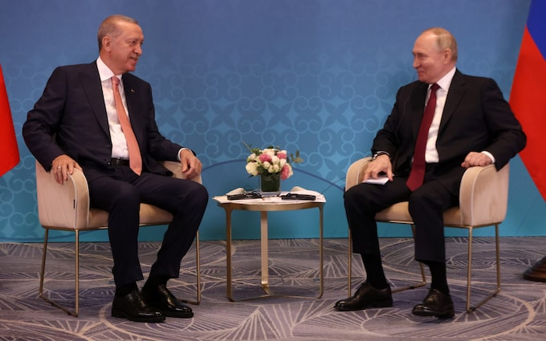
Putin and I are the only significant world leaders left, Erdogan says – Dec. 9, 2024

Slide 28

Israel showed the 'power' of F-35s in destroying nearly all of Iran's air defenses without a loss, UK admiral says

Slide 29
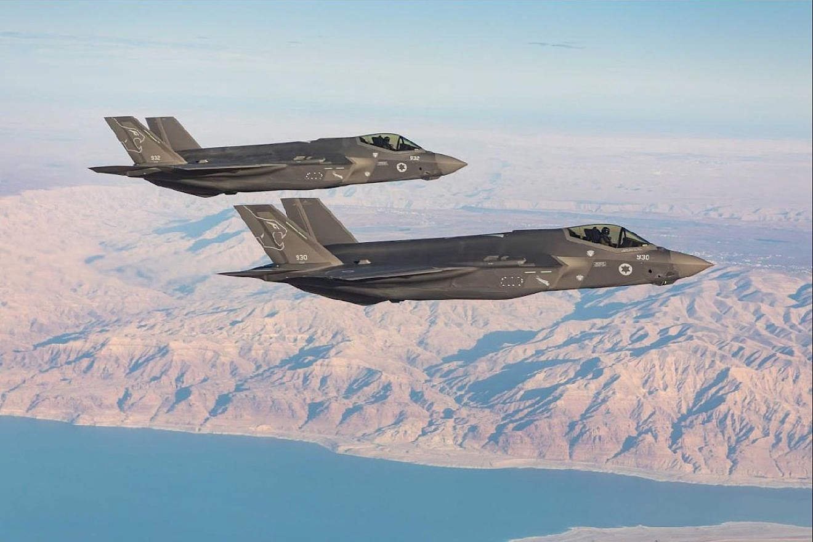
IDF hit more than 300 Syrian regime targets in two days, ‘effectively wiping out air force’

Slide 30
In historic campaign across Syria, IDF says it destroyed 80% of Assad regime’s military

Slide 31

UN approves major conference in push for Palestinian state
The General Assembly voted on Dec. 3, 2024, by a 157-8 margin with seven abstentions, in favor of holding a conference in June 2025

Slide 32
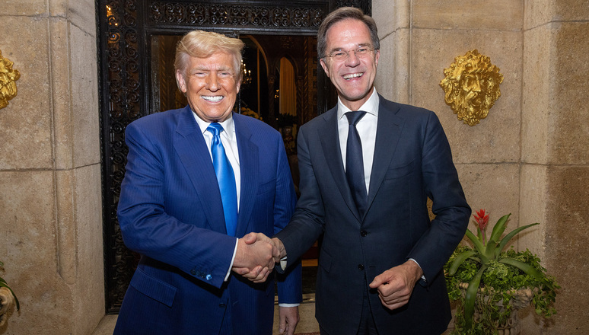
NATO Secretary General Mark Rutte met with
President-elect Donald Trump in Palm Beach, Florida on Friday, November 22

Slide 33
President Trump’s Nominees
Fulfilling Campaign Promises

Slide 34
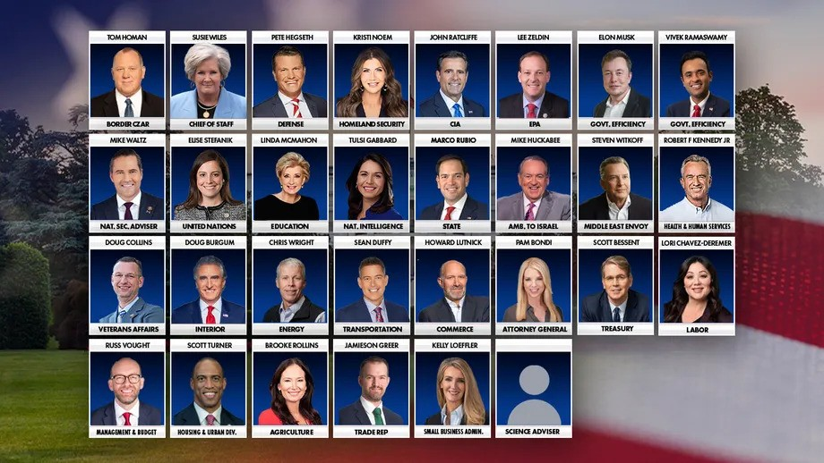

Slide 35
White House media worn out and possibly partially replaced

Slide 36
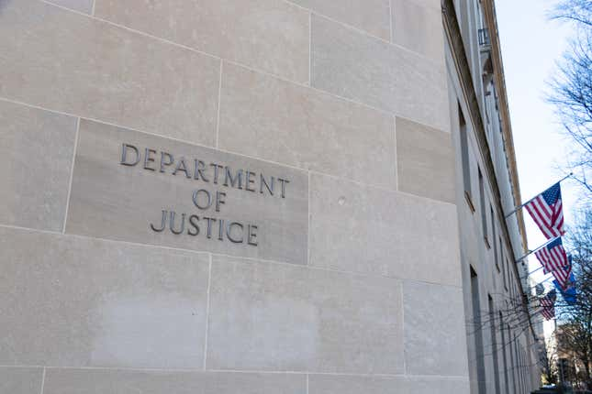
Donald Trump just picked who will take over the Google, Apple, and Visa monopoly cases

Slide 37
Trump’s Angelic Protection

