Slide 1
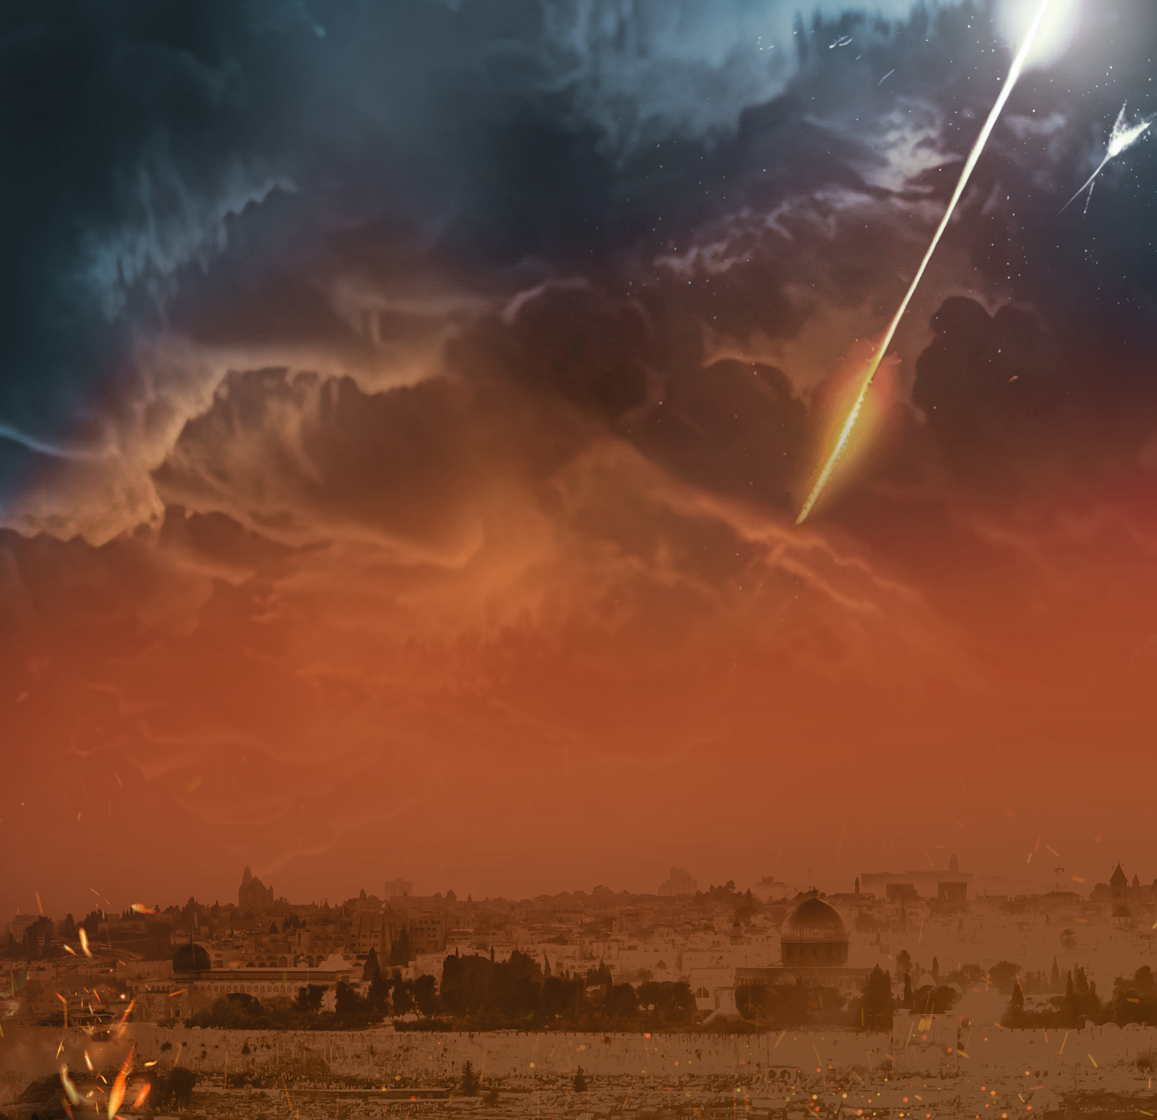
Seeing the End Times
through the Eyes of Jesus
Current Considerations from the Olivet Discourse
Jeff Kinley

Slide 2
Introduction
The Reality of the Last Days
Why Believe Jesus of Nazareth?

Slide 3
An Overview of Jesus’ Olivet Prophecies
Context
Jerusalem Will Be Destroyed (Matthew 24:1-2)
Humanity Will Be Deceived (Matthew 24:4-5, 11, 24-26)
Wars Will Be Fought (Matthew 24:6-8)
Believers Will Be Despised (Matthew 24:9-10)
Love Will Be Scarce (Matthew 24:12-13)
The Gospel Will Be Declared (Matthew 24:14)
The Temple Will Be Desecrated (Matthew 24:15-22)
The Antichrist Will Display Miracles (Matthew 24:23-26)

Slide 4
The Context and Timing (24:29)
The Condition of the World and Humanity
Billions Deceived and Deluded (2 Thess. 2:3-9)
The Seal Judgments (Rev 6) - Humanity’s Response?
Kill saints (6:9-11). Terror, no atheists (6:15-17).
The Trumpet Judgments (Rev 8-9) - Humanity’s Response?
Suicide attempts (9:6). Resurgence of Pagan Idolatry (9:20).
Stubborn Refusal to repent (9:20-21).

Slide 5
The Condition of the World and Humanity
Prior to Bowl Judgments, the Mark of the Beast is Received (14:9-11)
The Bowl Judgments (Rev 16:1-21) - Humanity’s Response?
Blaspheme God (16:9). Refuse to repent (6:9).
Judgment #5 - Darkness on AC Kingdom (16:10-11)
Response? “they blasphemed the God of Heaven (16:11).
Judgment #6 - 3 Demons released to prepare for Armageddon (16:12-16)
Purpose? To rally earth’s armies to fight the Lamb

Slide 6
The Condition of the World and Humanity (cont.)
Judgment #7 - Most devastating earthquake in history (16:17-21)
Fall of Babylon (16:19). Islands disappear , mountain ranges leveled (16:20). 100 lb. hailstones rain from the sky (16:21)
Humanity’s Response? They blaspheme God (16:21).
Chronological Recap of Humankind’s Tribulation Condition
Run. Hide. Rebel. Refuse to repent. Reject God, receive Antichrist.
Blaspheme God. Refuse to repent. Unite in order to kill God.
Psalm 2:1-6

Slide 7
What Happens When the Son of Man Returns?
Matthew 24:29-31
Planet earth will suffer a global blackout (29)
The heavens will violently shake (29)
The sign of the Son of Man will appear (30)
The shekinah glory of God will flashblind the earth (30)
All the elect will be gathered together (31)

Slide 8
What Happens at the Second Coming?
Revelation 19:11-15
From where is He coming? (11) - Heaven
How does He get here? (11) - He rides a white victory horse
What is His character like? (11) - Faithful and True
What is His mission (11) - To Judge and Wage War
What does He look like? (11) - His eyes are a flame of fire (1:14).
On His head are many crowns.
What is His “Secret Name?” (12) - No one knows
What is He wearing? (13) - A robe “dipped in blood”
(Isa. 63:1-6; Rev. 14:14-20)

Slide 9
What is His revealed Name? (13) - The Word of God (John 1:1, 14; 1 John 1:1). He’s the image of the invisible God (John 1:18; Hebrews 1:3)
Who’s riding with Him? (14) - The “armies of Heaven”
1. The Bride (19:7-8). 2. Tribulation Martyrs (7:9; 17:14). 3. O.T. Saints (Daniel 12:1-2). 4. Holy Angels (Matthew 25:31). How many?
Where does He land? (Zech. 14:4; Acts 1:10-11) - His feet touch the Mount of Olives, violently splitting it in two.
What is His only weapon? (15) - His Word.
What is His title? (15) - “KING OF KINGS AND LORD OF LORDS”

Slide 10
Why is Jesus Returning?
To Fulfill His Promise (Matt. 25:31; Acts 1:9-11; Zech. 14:4)
To Defeat His Enemies (Rev. 19:19-21)
To Redeem and Restore Israel (Isa. 43:5-6; Jer. 30:10; 33:6-9; Ezek. 36:24-38; 37:1-28; Isa. 11:11; Rom. 11:25-27)
To Judge unsaved Gentiles and Reward righteous ones (Matt. 25:31-46)
To Resurrect O.T. & Tribulation Saints (Rev. 20:4-6; Dan. 12:1-4)
To Bind Satan for 1,000 years (Rev. 20:1-3)
To Reign as the Unrivaled, Supreme King on Earth
(Rev. 19:6; Isa. 9:6; Dan. 2:44; Matt. 19:28; Luke 1:32-33)

Slide 11
What is Our Response to the Truth
of His Glorious Appearing?
Knowledge: Because you learn the mind and plan of God. His war is just and righteous. 3rd Bowl judgment - “they deserve it” (Rev. 16:6-7). Changes our minds.

Slide 12
What is Our Response to the Truth
of His Glorious Appearing?
Knowledge: Because you learn the mind and plan of God. His war is just and righteous. 3rd Bowl judgment - “they deserve it” (Rev. 16:6-7). Changes our minds.
Perspective: Because you see and understand reality and humanity as He does (Rom. 8:29-30; 1 Cor. 13:12; 15:49-51; 2 Cor. 5:2-4). Alters our vision.

Slide 13
What is Our Response to the Truth
of His Glorious Appearing?
Knowledge: Because you learn the mind and plan of God. His war is just and righteous. 3rd Bowl judgment - “they deserve it” (Rev. 16:6-7). Changes our minds.
Perspective: Because you see and understand reality and humanity as He does (Rom. 8:29-30; 1 Cor. 13:12; 15:49-51; 2 Cor. 5:2-4). Alters our vision.
Anticipation: Because you will have a front-row seat to the most epic moment in history. You will participate in His victory parade.
Heightens our expectancy.

Slide 14
What is Our Response to the Truth
of His Glorious Appearing?
Rejoicing: Because you will personally experience the prophetic plan of God (Rev. 19:1-14). Enhances our joy.

Slide 15
What is Our Response to the Truth
of His Glorious Appearing?
Rejoicing: Because you will personally experience the prophetic plan of God (Rev. 19:1-14). Enhances our joy.
Motivation: Warn the world, and invite sinners to make peace with this coming King (Luke 14:31-33). Inspires our witness.

Slide 16
What is Our Response to the Truth
of His Glorious Appearing?
Rejoicing: Because you will personally experience the prophetic plan of God (Rev. 19:1-14). Enhances our joy.
Motivation: Warn the world, and invite sinners to make peace with this coming King (Luke 14:31-33). Inspires our witness.
Worship: Because He is worthy (Rev. 4:11; 5:8-14). Fall before your coming King (Rev. 19:10; 22:20). Enlarges our worship.

Slide 17
Seeing the End Times
through the Eyes of Jesus
Current Considerations from the Olivet Discourse
Jeff Kinley

