Slide 2

Current Stage-Setting

Slide 3

I. The Period Timing / Chronology
II. The Participants Troops / Coalition

Slide 4
I. The Period Timing / Chronology
3 Timing Clues
1) “the latter years” (38:8)
“the last days” (38:16) 14X in the OT
2) Israel regathered

Slide 5
3) Israel at Rest
“living securely” (38:8, 11, 14; 39:6, 26)
securely, undisturbed
“rest” (38:11) “to allow one’s hands to drop, “drooping of the head”
“peaceful and undisturbed”
“the peaceful ones living securely”

Slide 6
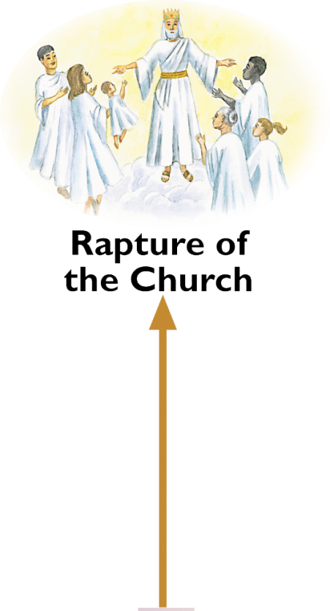
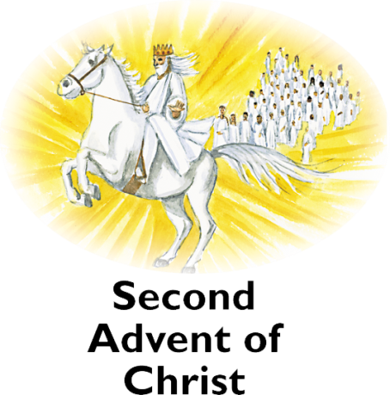




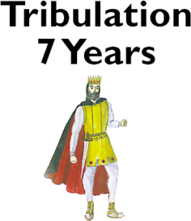
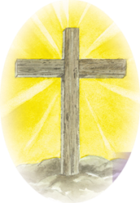



Panorama of Prophecy
Campaign of Armageddon
Peace Treaty
3 ½ years 3 ½ years
Gog Magog War
Antichrist’s world empire
Notes:
Ezekiel 39:9 “Seven years” Supports this being before the trib. Begins (Left Behind view)

Slide 7
Before the Tribulation
Strengths
Fits well with Ezek 39:9 (7 years)
Provides a reasonable explanation for the rebuilding of the Temple

Slide 8
Weakness
Can Israel’s condition today or before the tribulation be described as “living securely and “at rest”?

Slide 9
First Half of the Tribulation
Strengths
1) Provides a solid explanation for Israel’s peace and security.

Slide 10
Dr. John Walvoord
“There are some hints that provide a good clue as to when this battle will take place. One of the hints given is that the battle takes place at a time when Israel has been regathered into their ancient land, and is dwelling securely and at rest.
There are not too many times when Israel is at rest in God’s prophetic program. They have been scattered and persecuted over the face of the earth, and not even in the future will Israel have many periods of rest. Certainly, Israel is not at rest today. Israel is an armed camp. . . .

Slide 11
There is only one period in the future that clearly fits this description of Ezekiel, and this is the first half of Daniel’s seventieth week of God’s program for Israel (Dan 9:27)
Under that covenant, Israel will be able to relax, for their Gentile enemies will have become their friends, apparently guaranteeing their borders and promised them freedom. During that first three and one-half years, we have the one time when regathered Israel is at rest and secure. Apparently, Russia will invade the land of Israel during that period, possibly toward its close, and the Scripture will then be fulfilled.”

Slide 12
2) This view provides a reasonable scenario for the Antichrist’s ascent to world domination at the mid-point of the tribulation. If the armies of Russia and her Islamic allies are wiped out in Israel some time before the mid-point of the tribulation, this would create a massive power vacuum and a dramatic shift in the balance of power that would allow the Antichrist to ascend to world domination as predicted in Rev 13.

Slide 13
Weakness
The primary weakness of this view is that it does not deal very well with the 7 months of burying the dead and the 7 years of burning the weapons. However, if the invasion occurs at least 1 year before the mid-point of the tribulation, then it is possible for the dead bodies to be buried before the Antichrist invades Israel and begins his reign of terror. The burning of the weapons could continue into the beginning of the millennial kingdom.

Slide 14
End of the Tribulation
Strength
Parallel between Ezek 39:4, 17-20 and Rev 19:17-18

Slide 15
Weaknesses
1) Ezek 38 names specific allies; Armageddon involves all nations
2) Ezek 38 the armies are destroyed by fire and brimstone, plagues, and infighting. Rev 19 the armies are destroyed by the personal appearance of Jesus.
3) At the end of the tribulation, Israel will not be at rest and living securely.

Slide 16
Two-Phase Fulfillment
Dr. Harold Hoehner contends that Ezek 38–39 will be fulfilled in 2 phases. He believes Ezek 38 will be fulfilled early in the tribulation and Ezek 39 will be fulfilled at the end of the tribulation

Slide 17
Ralph Alexander contends that Ezek 38–39 have a double fulfillment in Rev 19:17-21 at the end of the tribulation and in Rev 20:8 at the end of the millennium with the former fulfillment prefiguring the latter

Slide 18
Strength
Harmonizes the text with other related texts.
Weakness
Ezek 38-39 appear to be describing the same invasion and its aftermath not 2 distinct phases separated by several years. Neither the text nor the context of Ezek 38–39 provide any indication that it will be fulfilled on two occasions.

Slide 19
End of the Millennium
Strength
Gog and Magog is mentioned in both Ezek 38-39 and Rev 20:7-10.

Slide 20
Weaknesses
1) Gog and Magog in Ezek 38–39 is before the millennium (Ezek 40–48); whereas, in Rev 20:7-10 the battle of Gog and Magog is after the millennium described in Rev 20:1-6.
2) In Ezek 38 specific nations are mentioned. In Rev 20 the coalition is “the nations which are in the four corners of the earth.”

Slide 21
2) In Ezek 39 the bodies of Gog and his troops are buried for 7 months, and the weapons are burned for 7 years after the battle, yet in Rev 20–21 the Great White Throne, new heaven and new earth, and eternal state immediately follow the final battle of Gog and Magog.
The post-millennial view would require the burying and burning to continue into the eternal state.

Slide 22
Explanations of the timing of Israel being “at rest / living securely”
1) Israel’s current condition fulfills this requirement
2) Psalm 83 War
3) Antichrist Treaty in Dan 9:27
4) The Trump peace plan

Slide 23
“Donald Trump’s Return Could Bring a More Peaceful Middle East” Time 11/9/24
Choke Iranian revenues and funding of regional terrorist groups through the long overdue re-enforcement of oil sanctions.
Stop Iran’s pursuit of a nuclear weapon, which is the gravest long-term regional security threat facing the Mideast.
Extend the Abraham Accords to build a strong coalition of allies to counter the Axis of Evil and facilitate a better life for the Palestinian people.

Slide 24
“Donald Trump Warns of 'Hell to Pay' Amid Middle East Hostage Crisis” Newsweek (12/2/24)
President-elect Donald Trump issued a stark warning Monday over the ongoing hostage crisis in Gaza, as regional tensions escalated with the first reported Hezbollah attack since implementation of a ceasefire along Israel's northern border.

Slide 25
In a message posted to his Truth Social platform, Trump demanded immediate release of all hostages held by Hamas, warning of unprecedented retaliation if the order goes unheeded by his inauguration date of January 20

Slide 26
"Please let this TRUTH serve to represent that if the hostages are not released prior to January 20, 2025, the date that I proudly assume Office as President of the United States, there will be ALL HELL TO PAY in the Middle East," Trump said, adding that "Those responsible will be hit harder than anybody has been hit in the long and storied History of the United States of America. RELEASE THE HOSTAGES NOW!"

Slide 27
“A new dawn and a new era of peace and prosperity could be on the horizon in the Middle East with Trump’s return.”

Slide 28
Daniel 9:27
NIV “He [the coming Antichrist] will confirm a covenant with many for one ‘seven.’”
ESV “And he shall make a strong covenant with many for one week”
“to be strong” “to overpower” “to exert oneself”
Notes:
Over 2500 years ago, Daniel foresaw the exact scenario that’s unfolding today. Strong confirmation that the Bible is divine in origin.

Slide 29
Can denote the idea of “enforcing” or “making strong” a covenant. In other words, he might enforce, confirm, or make strong a treaty that already exists.
Can also carry the idea of a forced, compelled covenant or treaty.

Slide 30
II. The Participants Troops
1) The Commander
Gog = Darkness 11x in Ezekiel 38—39
Called a prince
Directly addressed by God

Slide 31
Joel Rosenberg
“Over the years, people have asked me if Putin might be the Russian dictator referred to as “Gog” in the Biblical prophecies of “Gog and Magog” in Ezekiel 38-39. . . . Here’s my quick answer: It’s too soon to draw such a conclusion. There’s much more that would have to happen to indicate that Putin was the “Gog” of Bible prophecy. But there’s no question in my mind that Putin is Gog-esque. He is dangerous, and both Israel and the West should keep a close and wary eye on him, especially given all that Putin has done to build a strategic alliance between Russia and Iran and the other countries mentioned in the “Gog and Magog” prophecies.”

Slide 32
  2) The Coalition
  1. Magog
  2. Rosh
  3. Meshech
  4. Tubal
  5. Persia
  6. Cush
  7. Put
  8. Gomer
  9. Togarmah
  “many peoples with you”

Slide 33
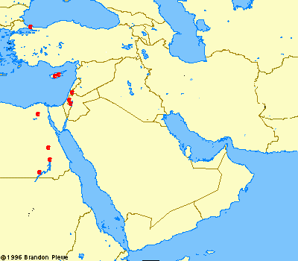
Rosh
Magog
Rosh
Meshech, Tubal, Gomer, Togarmah
Persia
Israel
Persia
Put
Ezekiel 38-39
Battle of Gog and Magog
Cush
Notes:
What about near enemies? Psalm 83 War
Koran mentions Gog and Magog 2x (yajuj and majuj)
What about Turkey?
10 proper names Gog—a person
7x “Thus saith the Lord God” This is God’s Word
Turkey Won’t be admitted to EU, will turn back to the East and to Islam for its influence and alliances.
Associated Press, January 16, 2008 “Turkish PM: Israel should be barred from UN” (Turning against Israel)
Turkey developing growing times with Iran
Ezekiel predicted all this with precision almost 2,600 years ago!!
Named the exact geographical locations.

Slide 34
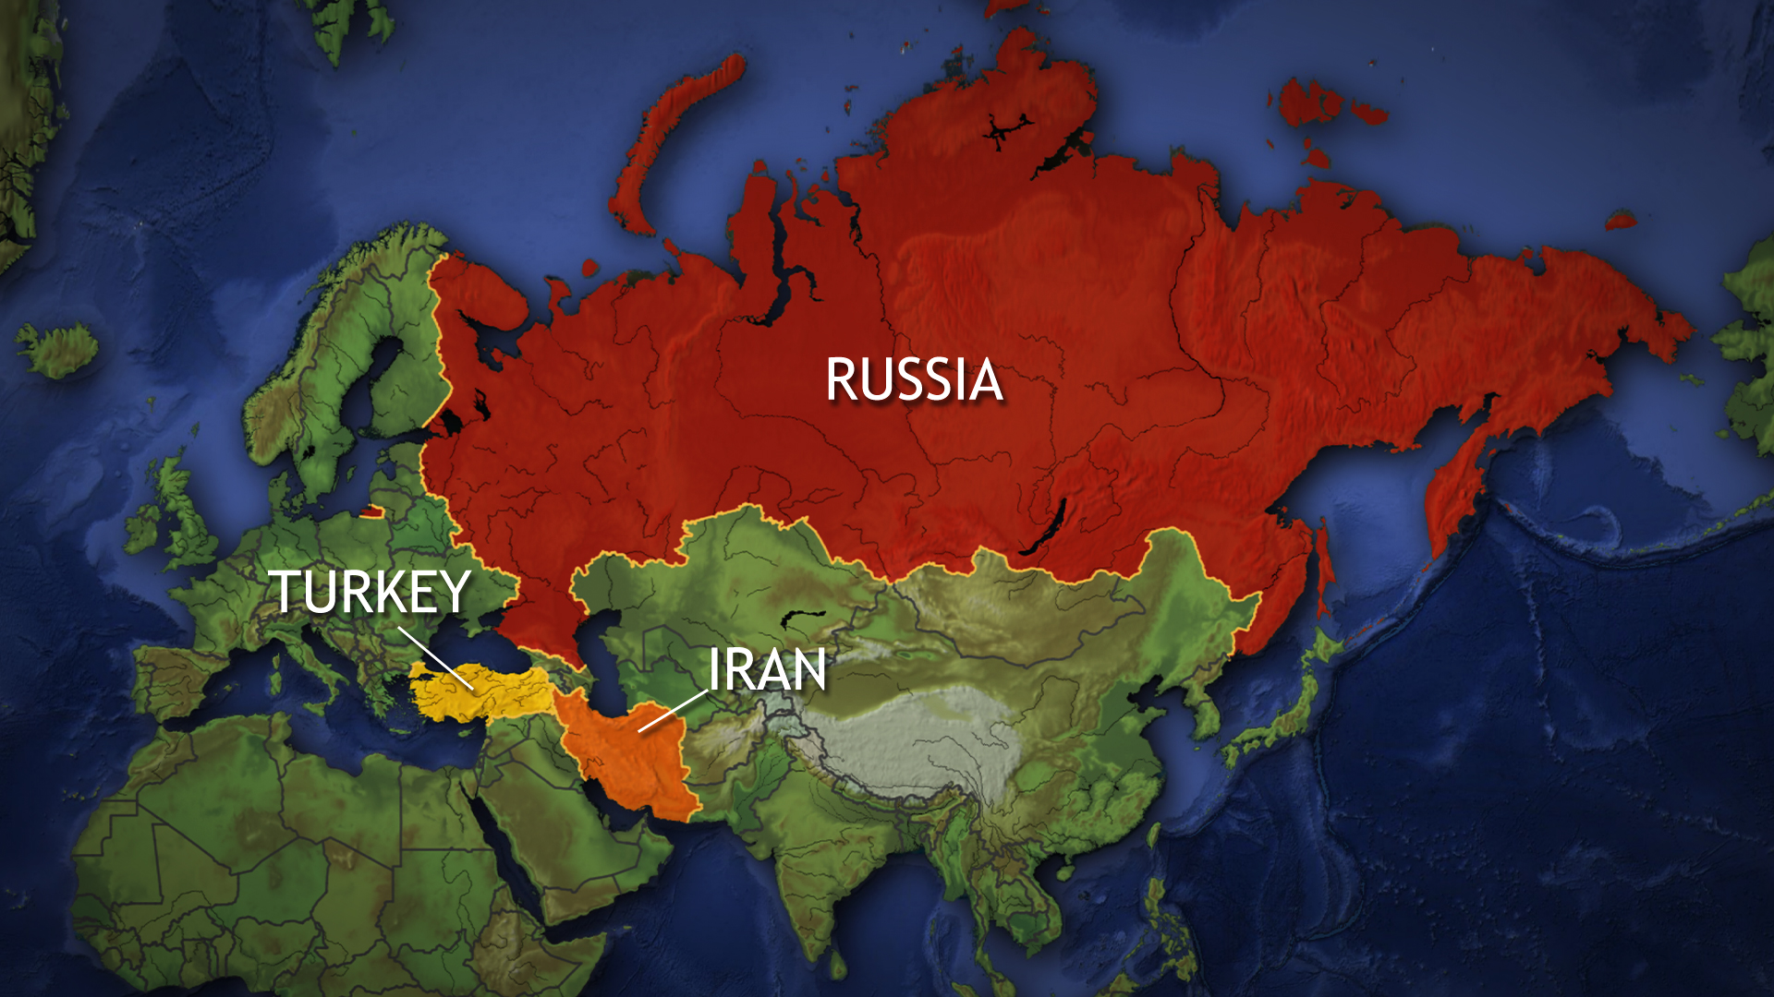
Rosh
Magog
Meshech, Tubal, Gomer, Togarmah
Persia
Israel
Put
Ezekiel 38-39
Cush
Notes:
What about near enemies?
Psalm 83 Isaiah 17 Damascus

Slide 35
Iran
Notes:
Russia is escalating economic, political and military ties with Iran and Turkey

Slide 36
Turkey
“Erdogan says Turkey might enter Israel to help Palestinians” Reuters 7/28/24
“Turkey Cuts Off Relations With Israel” Newsweek (11/13/24)

Slide 37
“many peoples with you” (Ezekiel 38:6)
1) Inner ring of nations
2) The Axis of Resistance (Iranian proxies)
Gaza (Hamas)
Lebanon (Hezbollah)
Syria
Iraq (numerous militia groups)
West Bank
Yemen (Houthis)
Notes:
Indicates the list is not exhaustive

Slide 38
3) Russian mercenaries like those being recruited in Ukraine
Yemen (Russia has recruited “hundreds” of Houthi fighters)
N. Korea (11,000)
Nepal (15,000)

Slide 39
Current events point toward the Gog-Magog War.
The timing could be before the rapture or before the Tribulation if the precondition of rest and security is in place.
The coalition is coalescing before our eyes.

